Slide 1

Recognition of Face Emotion in Real Time
DIGITAL IMAGE PROCESSING MINI PROJECT
Presented by:
Anushree YN
G Venkata Sai Akhil
Md Imtiyaz Alam

Slide 2
Problem Statement
The objective of this project is to develop a real-time facial emotion recognition system using a Convolutional Neural Network (CNN) model. The system will be able to accurately detect and classify the emotions expressed by individuals in live video streams or captured frames.
The CNN model will be trained on a labeled dataset of facial expressions, consisting of images or video frames representing different emotions such as happiness, sadness, anger, fear, surprise, and neutral. The model will learn to extract relevant features from facial images and classify them into appropriate emotion categories.

Slide 3
The Human Face and Emotion
The Anatomy of Facial Expressions
Facial expressions are based on a set of universal, innate signals that signal basic emotions such as happiness, sadness, fear, anger, surprise, and disgust.
1
2
3
The Face: A Mirror of Emotions
The Science of Facial Emotion Detection
Human emotions can be recognized and observed from the facial expressions, which are determined by the movements of facial muscles and the positioning of key features.
Facial emotion detection is a computational technique that involves analyzing and interpreting facial cues using advanced machine learning algorithms and computer vision methods.

Slide 4
Training a CNN Model for Facial Emotion Detection
1
Data Collection and Annotation
The success of the CNN model depends on the quality, quantity, and diversity of the training data used. The data needs to be annotated with the correct emotions and expressions.
2
Data Preprocessing and Augmentation
The input images need to be normalized, resized, and enhanced to improve the quality and consistency of the training data. Data augmentation techniques like cropping, mirroring, flipping or rotating can increase the size of the training set and prevent overfitting.
3
Model Design and Optimization
The choice of the CNN architecture, hyperparameters, optimization algorithm, and loss function can impact the performance and generalization of the model. Fine-tuning pre-trained CNN models can lead to faster and better convergence.
4
Performance Evaluation and Testing
The CNN model needs to be evaluated on a separate validation and test set, and performance metrics such as accuracy, precision, recall, F1-score, and confusion matrix need to be computed and analyzed.

Slide 5
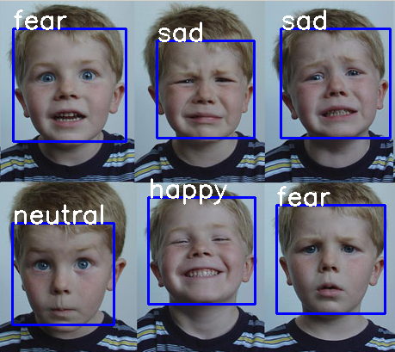
Output

Slide 6
Performance Evaluation Metrics for Facial Emotion Detection
Accuracy
Precision and Recall
F1-Score and Confusion Matrix
Accuracy measures the proportion of true positive and true negative predictions out of all predictions, and can be a misleading metric if the class distribution is skewed or the classes are imbalanced.
Precision measures the proportion of true positive predictions out of all positive predictions, and recall measures the proportion of true positive predictions out of all actual positive examples.
The F1-score measures the harmonic mean between precision and recall, and provides a balanced trade-off between them. The confusion matrix visualizes the performance of the model and allows to see which classes are confused the most.

Slide 7


Applications of Facial Emotion Detection in Real-Life Scenarios
Psychology Research
Forensics and Law Enforcement
Facial emotion detection can be used to study human emotions, behavior, and mental health, and can provide insights into conditions like autism, depression, or anxiety.
Facial emotion detection can be used to analyze criminal activity, identify suspects, and reconstruct events from video footage or photographs.

Slide 8
Conclusion
1
Facial Emotion Detection is a Revolutionary Technology
2
CNNs are a Powerful Tool for Facial Emotion Detection
3
Future Challenges and Directions
Facial emotion detection still faces many challenges and limitations, such as privacy concerns, cross-cultural differences, and emotional context. Future research can help address these challenges and explore new directions for this exciting technology.
Facial emotion detection is a cutting-edge technology that has the potential to revolutionize various fields, from psychology and healthcare to marketing and entertainment.
CNNs have proven to be effective and efficient tools for facial emotion detection, and can achieve state-of-the-art performance on various benchmarks and datasets.

Slide 9
THANK YOU

